Slide 1
The School District of Alachua County
Presentation of the African and African American Studies Curriculum Initiative
Overview of the Legal, Structure and Curriculum Requirements
Presentation to the Alachua County African American History Task Force
Implementation of the African and African American Studies Curriculum Initiative
by
Dr. Patrick Coggins, Consultant
Ph.D., JD, LLD (Hon), EdS.,M.S
September 6,2019

Slide 2

Purpose is to update Alachua County Stakeholders on the African-American Studies Curriculum Initiative
The purpose of this Presentation is to appraise the African American History Task Force about the Implementation processes related to the African and African American Studies Curriculum Initiative.
A+

Slide 3
Presentation to Alachua County African American History Task Force headed by Dr.Gordon.Professor Emeritus
Implementation of the K-12
Comprehensive
Interdisciplinary African and African American Studies
Curriculum Initiative

Slide 4


The Ultimate Goal of Today’s Session
To enable community stakeholders to understand the relevant curriculum strategies to teach the African and African American Studies and Cultures while enhancing the academic achievement for all students

Slide 5
WHY THE AFRICAN AND AMERICAN STUDIES CURRICULUM FRAMEWORKS?
FOCUS IS:
To Correct past omissions and inaccuracies.
Supplement partial information which is lacking in many textbooks.
To Integrate African and African American History and Contributions.
Avoid teaching African America History as an appendage.
To Go beyond teaching African American History during Black History month of February.
To Develop units written by teachers as “Teacher Friendly” resources.
Involve the Community in the content of the local history and other areas.

Slide 6
Specific Objectives of the African and African American Studies Curriculum Initiative
The Objectives include:
Short Term:
  Affirm the Implementation of the African and African American Studies curriculum by teaching rigorous elective and infused courses in African and African American Studies.
  Achieve Exemplary Status in Spring of 2020 from the Florida Commissioner of Education African American History Task Force.
  Long Term Goals:
  To systematically infuse African and African American Studies and Contributions into core subjects including Language Arts, STEAM, Humanities, Social Studies and other subjects within the scope of the seven (7) elements of the African and African and African American Studies Model.
  Secure consensus on the African and African American Studies Curriculum Frameworks to be implemented as a seamless part of the District’s curriculum.
  Assist in “Closing the Achievement Gap “

Slide 7
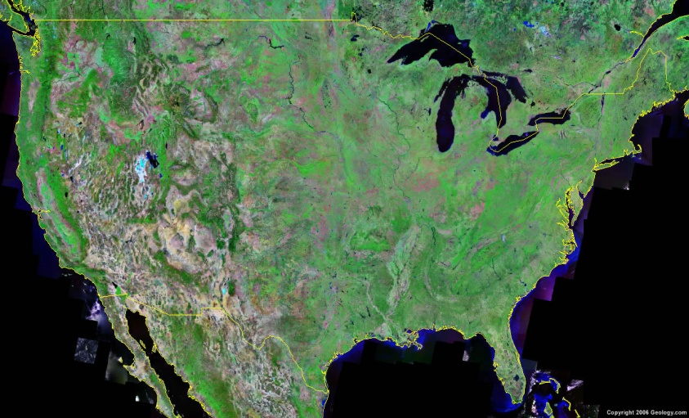
Overview of African and African American Studies Curriculum
The African and African American Curriculum will be one of the vehicles to enhance student achievement and close the achievement gap with the infusion of the legacy and roots in Ancient Africa, the Diaspora, the Americas and the world. Unique perspectives on freedom, justice, and equality are major portions of this evolving legacy that will be infused in the African and African American studies Curriculum.
The Rationale
“The Why”

Slide 8

Overview cont’d
The Vision
"The What"
The African and African American Infusion Curriculum will enable students to experience a school culture of inclusiveness and respect for all cultures through the infusion of the African and African American studies content throughout the district’s curriculum.
Africa

Slide 9
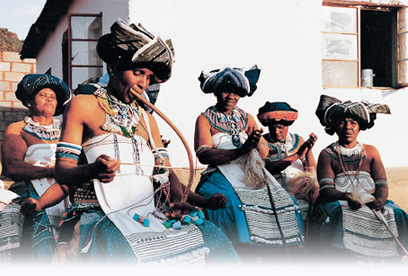
Overview cont’d
The Mission
"The How"
To develop and infuse the African and African American historic and contemporary experiences into the ACPS Curriculum This infused K-12 curriculum will show the rich contributions of Africans and African Americans in Florida, United States and the world.
.

Slide 10

FOCUS I
The Factors which are driving the implementation of the Florida Statute 233:061.(2),1994 as amended by Florida Statute 1003.42 (2)(h)2002

Slide 11
THE NEW FLORIDA LAW

Slide 12
Understanding the Florida Educational Goals and Laws that are included in Florida Statute 1003.42,(1994), as Amended (2002)
The Declaration of Independence
Republican Form of Government
U.S. Constitution
Flag Education, Display and Flag Salute
Civil Government
History of Holocaust (1933-1945)
History of African Americans
Study of Hispanic Contributions to the United States
Study of Women’s Contributions
Character Development
Education for Speakers of Other Languages (ESOL) FS 1011.62
Accomplished Practices
Diversity: Uses teaching and learning strategies that reflect each student’s culture, learning styles, special needs and socio-economic background.

Slide 13


NO TIME FOR MISTAKES
“There is no mistake so great
As the mistake of not going on”
You were running a good race, who cut in on you and kept you from obeying the truth”( Galatians 5:7)

Slide 14
The Florida Statute
In 1994 and 2002, the Florida Legislature passed the following law that required instruction for African and African American History:
“§ 233.061 (2) (g) 1994 and 1003.42 (2) (h) 2002 as amended, F.S. reads, “The history of African Americans, including the history of African people before the political conflicts that led to the development of slavery, the passage to America, the enslavement experience, abolition, and the contributions of African Americans to society.”
This law provides that, “Members of the instructional staff of the public schools shall teach efficiently and faithfully, using books and materials required, following prescribed course of study, and employing approved methods of instruction.”

Slide 15
Why Teach It? It is the Law
To teach African and African American Studies is to teach American history
The research shows that teaching African and African American Studies:
  Enhances self esteem of African American and all children.
  Increases student academic performance.
  Increases positive perception of African Descent and African Americans as a group in American society, the world and especially Alachua County.
© Copyright 2009. Dr. Patrick Coggins & P.C. Coggins & Associates. 15

Slide 16

Strengthening Self Efficacy and DEBUNKING THE DEFICIT MODEL
Cognition is shaped by ideas/information.
“When an individual fails to teach or learn their history and culture sooner or later it will be forgotten and the individual or group will be rendered nameless and faceless.”
Carter G. Woodson (1926)
Notes:
EX #1--Who is the Father of Negro History Week! Forerunner of Black History Month?

Slide 17
Paradigm Shift is Calling
Chinese and Japanese argue:
“When a student is not succeeding and have low scores, it is a not sign of low ability, but rather, it should be evidence that the student has not yet achieved his/her potential through persistence and hard work”
(Stevenson & Sigler 2003, Gay, 2003)

Slide 18

African and African American Studies Curriculum Initiative
Theme:
  Building a bright future based on real student achievement for African Americans students and all students in the School District of Alachua County.

Slide 19
MORAL VS. LEGAL ISSUE?
THE QUESTION THAT EACH EDUCATOR MUST ANSWER AS HE/SHE CONTEMPLATES THE TEACHING OF THE CURRICULUM IN AFRICAN DESCENT AND AFRICAN AMERICANS IS; “WHETHER THE DRIVING FORCE IS A MORAL IMPERATIVE OR A LEGAL IMPERATIVE REQUIRED INSTRUCTION FROM K-12 ALL SUBJECT AREAS?”

Slide 20
MORAL REASON FOR TEACHING AFRICAN AMERICAN HISTORY TODAY
Dr. Carter G. Woodson, in his 1957 book on the Miseducation of the Negro argued vigorously that his research (1926-1950s) showed that the failure to teach African Americans their history has been the source of miseducation.
Dr. Woodson’s research in 1926 can be summarized in his own words,
  “When a group or ethnic group fails to teach their history and culture, sooner or later that history and culture will be forgotten and the group or ethnic group will be rendered nameless and faceless.” (Woodson, p.27)

Slide 21
ACADEMIC ACHIEVEMENT IS POSSIBLE
COGNITION IS SHAPED BY THE IMAGES We receive and perceive such as “CCI”
CULTURE AND CULTURAL INFORMATION
EVIDENCE THAT PHD IN 2010 from FAMU FOUND THAT “THE students who received the African and African American Studies content did better on FCAT TESTS”
Banks(2009) found that ”There is a strong relationship between culture and positive academic performance”

Slide 22

WHAT WE HEAR DETERMINES OUR DESTINY
“It is not what you tell people that counts
It’s what they hear”
“In the space age…….
The most important space is between the ears”

Slide 23

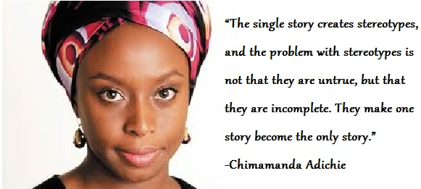
THE DANGER OF A SINGLE STORY
Novelist Chimamanda Adichie tells the story of how she found her authentic cultural voice -- and warns that if we hear only a single story about another person or country, we risk a critical misunderstanding.

Slide 24
The Curriculum will Focus On?
1.The seven (7) elements of the requirement in 1003.42(2)(h)2002
2. Recommended content areas for teachers to include in the curriculum
3 Develop units, and lessons/modules in the content areas and post these electronically.

Slide 26
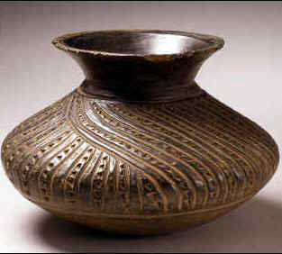
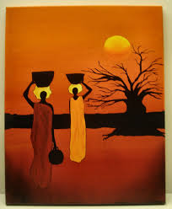
AN EFFECTIVE MODEL FOR AFRICAN AND AFRICAN AMERICAN STUDIES CURRICULUM

Slide 28
FOCUS II
What are the keys to successful implementation of the curriculum on African and African American History Curriculum?

Slide 29

Aligning Differentiated Instruction with Culturally Responsive Pedagogy
“The creation of a culturally responsive education system, grounded in the belief that all culturally and linguistically diverse students can excel in school when their culture, language, heritage and experiences are valued and used to facilitate their learning and development and they are provided access to high quality teachers, programs, and resources” (Metropolitan Center for Urban Education, 2008, p. 2).

Slide 30
Know the elements of the law.
Believe that all students have a right to be taught their culture and history .
Carter G. Woodson (1926) – Father of Negro (Black) History Week/Month.
Use a curriculum infusion strategy that Links whatever we teach to the Standards and District requirements
Focus on all seven (7) elements of the model by Coggins (1994).

Slide 31
INFUSION MODEL as District’s Goal
Consider the benefits of an Infusion Model
single courses will evolve at various grade levels.
Move to an Infused and Integrated Curriculum

Slide 32
This figure illustrates how a concept such as culture can be viewed from the perspectives of a number of disciplines and areas. Anyone discipline gives only a partial understanding of a concept, social problem or issue. Thus, ethnic studies units, lessons, and programs should be interdisciplinary and cut across disciplinary lines.
Studying ethnic cultures from an interdisciplinary perspective.

Slide 33
Elements of National Culture
European Descent
African Americans & African Descent
Hispanics
Shared National Culture
Pacific Islanders
Asians
Other Sub Groups
Middle Easterners
Native American Indians

Slide 34

Relationship between Culture and School Failure
Lack of student success stems from a lack of synchronization between students and their teachers, as well as the school’s culture and the student’s cultures (Irvine,1990; Howard,2006).

Slide 35
RESEARCH IN SUPPORT
Thus, the need to teach the unique history of African Americans is highlighted by Carl Grant (1995), in Educating for Diversity and James Banks in Teaching Strategies in Ethnic Studies (1997, 2003), whose research and books state,
  “Any program aiming to increase positive interaction among racial groups must include processes, which teach people the unique histories and qualities of the ethnic groups involved,” (p.21). The key variable in ensuring such instruction is a well informed teacher and administrator.” (Grant, 1995; Banks, 1997, 2003)

Slide 36
RESEARCH IN SUPPORT
Thus, Ruby Payne, Irvine (1990), Erickson (1987), Au and Kawakami (1991), and Asante (1998) all argued that their research and experiences conclude that,
“Only when teachers understand the cultural and historical background of students can they comprehend and react positively to minority students while enhancing their academic achievement.”

Slide 37

African and African American Studies Curriculum Benefits All
Geneva Gay (1995), in the chapter entitled, “African American Culture and Contributions to American Life,” in Educating for Diversity (Grant et al, 1995, p.38) argued that her research found that to preserve the African American Culture, it will require the study of African American Studies as a means of enhancing the quality of life for all.
“The study of African history, culture and contributions should be an integral part of the education of all students in all grades, subjects and settings.”
“It makes no difference whether students are African, Asian, Hispanic, of European descent, Native American, or other group ancestry.”

Slide 38
Criteria for Exemplary District
Six Criteria for Being Considered an Exemplary School District for the Implementation of the African and African American Studies Curriculum

Slide 39
Criteria for Being Identified as an Exemplary School District
School Board approval of the African and African American Studies curriculum initiative
Structured Professional Development
Evidence of the development of an African and African American Studies curriculum for infusion
Evidence of Structured Teaching of the African and African American Studies Curriculum (180+ days).
Evidence of University School District Collaboration
Evidence of Parent and Community partnerships and involvement

Slide 40
Criteria for Being Identified as an Exemplary School District
1. School Board approval of the African and African American Studies initiative.
Evidence that the school board has developed a plan for the implementation of the Florida African and African American history required instruction.
Evidence that the plan has been publicized in School District’s curriculum guides etc.

Slide 41
Criteria for Being Identified as an Exemplary School District
2. Structured Professional Development
Evidence that the school district has developed and implemented an ongoing professional development plan for training teachers, students and school staff in strategies for teaching African and African American Studies Curricula.
Evidence that adequate resources have been allocated to structured professional development programs and for enhancing the instruction of African and African American Studies in an infused format.

Slide 42
Criteria for Being Identified as an Exemplary School District
3. African American Studies Curriculum
Evidence of African and African American Studies Curriculum Frameworks K-12 has been integrated as part of its school district policy with respect to required curriculum.
Evidence that the curriculum has been disseminated to curriculum specialists, teachers, media specialists and other educators in the district.
Evidence that there are adequate teaching resources including books, CD’s and lesson plans available to support this required instruction.

Slide 43
Criteria for Being Identified as an Exemplary School District
4. Structured Teaching of the African and African American Studies Curriculum
Evidence that the African and African American Studies content appears in lesson plans over the sustained period of 180 plus days.
Evidence that there are approved methods for teaching and assessing the African and African American Studies Curriculum.
Evidence that there the African American history content is infused and linked to the FSA and other high stake tests and requirements.
Evidence that the African and African American Studies content are infused in all subject areas.

Slide 44
Criteria for Being Identified as an Exemplary School District
5. University -School District Collaboration
Evidence of university involvement in professional development, curriculum and instruction support, etc.
Evidence of school district university partnership in seeking external funding (federal grants, foundation grants, etc.)
Evidence that the school district and university partnership has aided in the preparation of pre-professional teachers and other educators.

Slide 45
Criteria for Being Identified as an Exemplary School District
6. Parent/Community Partnerships
Evidence that the school district’s initiatives in African and African American Studies has resulted in the development of strategies that include the involvement of parents through awareness information sessions.
Evidence that there are community partners who are involved in the development and ongoing implementation of the African and African American Studies curriculum.

Slide 46
I. Action Plan
Recap of Where We Are
Recap of where we are:
The Alachua County School District approved the implementation of the African and African American Studies Curriculum.
Planning meeting with key District Staff to review the Action Plan and decide on the African and African American Studies Timetable for Implementation.
It was decided that Jon Rehm will assume coordination responsibility for the project, while
Dr. Patrick Coggins/ Dr. Jon Rehm will coordinate the activities of the Writing Team, District and African American Advisory Committee/Staff Development with help from Superintendent’s staff in developing the FOCUS Lesson Plan system and community relations.

Slide 47
Deputy Super. for Curric.
Executive Director of Curriculum
District Equity Director
District Coord. AAASC
Principal of Each School
Diversity initiatives, African Descent, Hispanics, Asians, Native Americans
AC African American History Task Force
School Coordin-ating Teachers
Teachers K-12
District School Superintendent Mrs. Karen Clarke
Florida Statute 1003.42 (2)(h), 1994, 2002
AAASC
Content K-12
Alachua School Board
All Grades/
All Subject Areas
African and African American Studies Curriculum Infusion Model
Staff Development K-12
All Content
AAASC Units/Lessons on District Website
- CPALMS -
State AAAHT
Task Force
District-wide Staff Develop-ment
State-wide AAAHS Developed.
Elec-tronic
Access of Lessons
Method-ology Delivery System
School-based SD
Printed Units/
Lessons K-12

Slide 48
Alachua County School
District African American and African American Studies Advisory Task Force
Donna Jones- Deputy Superintendent
Valerie Freeman- Director of Equity and Outreach
Jennifer Wise- Executive Director of K-12 Curriculum

Slide 49
ALACHUA County School District
African and African American Studies Curriculum
WRITING TEAM MEMBERS: (Includes, but not limited to the following)
Elementary School
Middle School
High School
School District
*Partial Listing

Slide 50
Activity 5 – Focus Unit and Module Format
Each unit will include the following content:
Appropriate grade level(s) and subject area(s)
Next Generation Sunshine State Standards
Unit objectives and essential questions
Cultural content/contextual information to be learned
Lesson specific vocabulary
Timelines related to African American/American History, etc.
Link to the 7 elements of African/ African American Study
Focus area of the world
Assessment Criteria
Each Module will include the following content:
Background in relation to cultural content/ context
NGSSS specific to module
Clear activities linked to the unit objectives
Technological and material needs
Evidence of critical thinking skills
Detailed references

Slide 51
Curriculum Products to be Developed
Elementary School
Grade | Total Units | Total Modules
K | 1 | 5
1 | 1 | 5
2 | 1 | 5
3 | 1 | 5
4 | 1 | 5
5 | 1 | 5
Total | 6 | 30

Slide 52
Curriculum Products to be Developed
Middle School
Grade | HIS/SS | LA | SCI | MATH | HUM/ARTS | TOTAL UNITS | TOTAL MODULES
GRADE 6 | 1 | 1 | 1 | 1 | 1 | 5 | 25
GRADE 7 | 1 | 1 | 1 | 1 | 1 | 5 | 25
GRADE 8 | 1 | 1 | 1 | 1 | 1 | 5 | 25
Total | 3 | 3 | 3 | 3 | 3 | 15 | 75

Slide 53
Curriculum Products to be Developed
High School
GRADES | HIS/SS | LA | SCI | MATH | HUM/ ARTS | Career Tech | TOTAL UNITS | TOTAL MODULES
GRADE 9 | 1 | 1 | 1 | 1 | 1 | 1 | 6 | 30
GRADE 10 | 1 | 1 | 1 | 1 | 1 | 1 | 6 | 30
GRADE 11 | 1 | 1 | 1 | 1 | 1 | 1 | 6 | 30
GRADE 12 | 1 | 1 | 1 | 1 | 1 | 1 | 6 | 30
Total | 4 | 4 | 4 | 4 | 4 | 4 | 24 | 120

Slide 54

Curriculum Products to be Developed
Total
Units Modules
Elementary - Grades K-5 = 6 30
Middle - Grades 6-8 = 15 75
High - Grades 9-12 = 24 120 TOTAL = 45 225
Curriculum 45 Units with 5 Lessons each = 225 Modules/ Lessons Available to teachers

Slide 55
Let’s Go to the Website…

Slide 56

Next Steps For Alachua County District
Commit to the completion of the Units and Lesson plans grade level specific on or before and possible unveil the curriculum in February 2020 and complete it all by JULY 2020.
Develop a creative monitoring and assessment strategy to ensure that the African and African American Studies content is taught to every student in ALACHUA’s Schools.
Ensure that the curriculum, units, resource units, and lesson plans are on-line and easily accessible to educators on or before February 1,2020 and completed by the end of the school year June,2020.
Prepare a report of the African and African American Studies Curriculum Plan for Board approval in the month of FEBRUARY 2020.

Slide 57

Next Steps for Alachua County District
5. Ensure that there is inclusion of the essential questions, FOCUS lessons and resource units into a seamless curriculum process that integrates African and African American Studies and culture studies in Social Studies, Language Arts, Science, Math and Humanities and other content areas by June 2020.
6. Select Coordinators in each school in the district to assist in the implementation of the African and African American Studies Curriculum.
7. Designate African and African American Studies Training dates for staff development. Include in the District’s Staff Development Schedule immediately in June 2020.
8. Select and train Writing Team on October 18,2019
9. Develop and implement a marketing strategy that will inform the public, the schools, Community groups and organizations, students and other interested entities and parties immediately by October 30,2019.

Slide 58

WHAT IS SUCCESS?
“Success is a journey not a Destination”
“What you get by reaching your destination is not nearly as important as what you become by reaching that destination”
As we work towards the infusion of African and African American studies in the curriculum remember we are changing lives of our students, ourselves and our community”

Slide 59

Managing The Curriculum Initiative:
A Final Perspective
“THE ATMOSPHERE YOU CREATE DETERMINES THE POSITIVE CROSS-CULTURAL RESULTS YOU PRODUCE.”
“Imagination is more important than Knowledge.”
(Albert Einstein)
“The future never first happened; it was created. We must create a culturally sensitive, linguistic, and culturally competent classroom/school environment.”
(Coggins)
So it is all about “students, faculty and administrators celebrating cultures in an inclusive atmosphere.”
(Coggins)

Slide 60

Thank you!
“A good plan vigorously executed right now is far better than a perfect plan executed next week.”
(General George Patton)
“There are risks and costs to a Program of Action- But they are less than the long-range risks and cost of comfortable inaction.”
(John F. Kennedy)

Slide 61
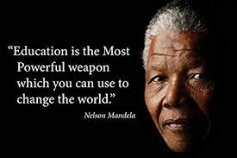
Closing
https://www.youtube.com/watch?v=XYTtcLUWyCU

Slide 62
Thank you!
Thank you!

Slide 63
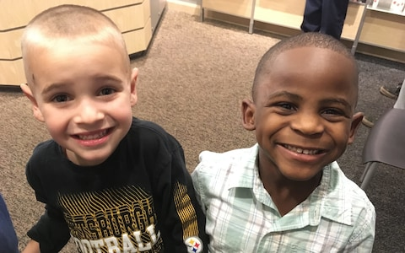
What disparities?
If both of these young boys engaged in the same behavior in class, chances are far greater that the boy on your right would be punished.
That’s a disparity.

Slide 64
3 times
2 times
This need not remain the status quo
African American Students are
As likely to get suspended as white students
They lose
Did you know?
as many days of instruction as a result of exclusionary discipline

Slide 65
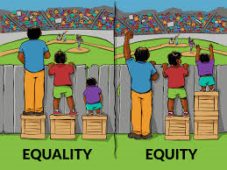
Hmmm…
https://www.youtube.com/watch?v=b9Auw0MzW50

Slide 66

AFRICAN AND AFRICAN AMERICAN STUDIES
FOCUS LESSON / UNIT PLANS
ELEMENTARY

Slide 67

AFRICAN AND AFRICAN AMERICAN sTUDIES CURRICULUM MATRIX
Grades
K - 5

Slide 68
AFRICAN AND AFRICAN AMERICAN STUDIES
FOCUS LESSON / UNIT PLANS
MIDDLE SCHOOL
Grades 6-8

Slide 69

Brain Break
Notes:
2:40

Slide 70

AFRICAN AND AFRICAN AMERICAN STUDIES CULTURE
CURRICULUM MATRIX
Grades
9-12

Slide 71


Culturally Responsive Educational Practices Include…
Explicit Instruction in Critical and Foundational Skills
Cooperative Learning Peer-assisted Learning
Supports
for ELL
Multicultural Education
PBS
Culturally Responsive Practices
Collaborative Problem Solving, Direct Assessments, and Multi-tiered Supports

Slide 72
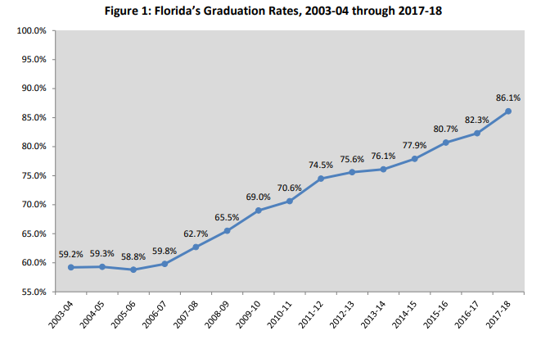

Slide 73
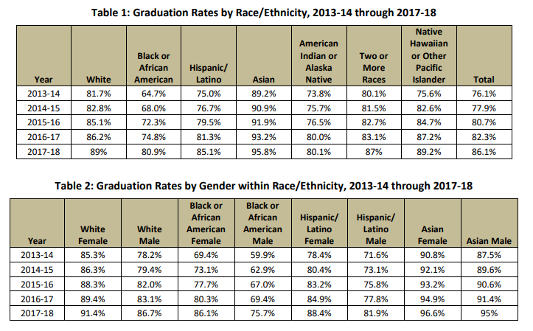

Slide 74
Diversity initiatives, African Descent, Hispanics, Asians, Native Americans
Asst. Super. for Curric.
District Core Subject Super-visor
District Coord. AAASC Dr.Rhem
Principal of Each School
School Coordin-ating Teacher
Teachers K-12
School Super. Dr. Clark
Florida Statute 1003.42 (2)(h), 1994, 2002
AAASC
Content K-12
Alachua School Board
All Grades/
All Subject Areas
African and African American Studies Curriculum Infusion Model
Staff Development K-12
All Content
AAASC Units/Lessons on District Website
- CPALMS -
State AAAHT
Task Force
District-wide Staff Develop-ment
State-wide AAAHS Develop.
Method-ology Delivery System
School-based SD
Elec-tronic
Access of Lessons
Printed Units/
Lessons K-12

Slide 75
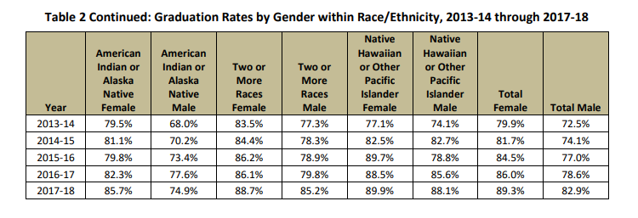

Slide 76
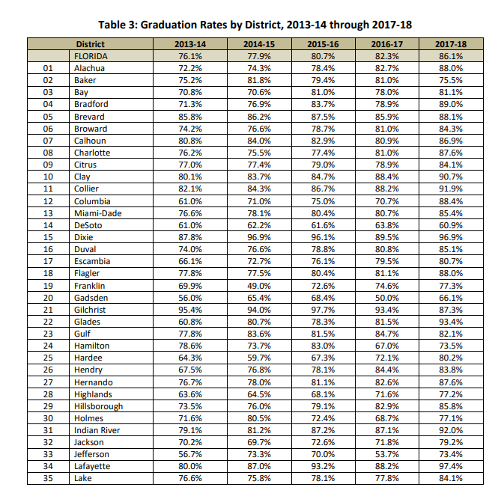
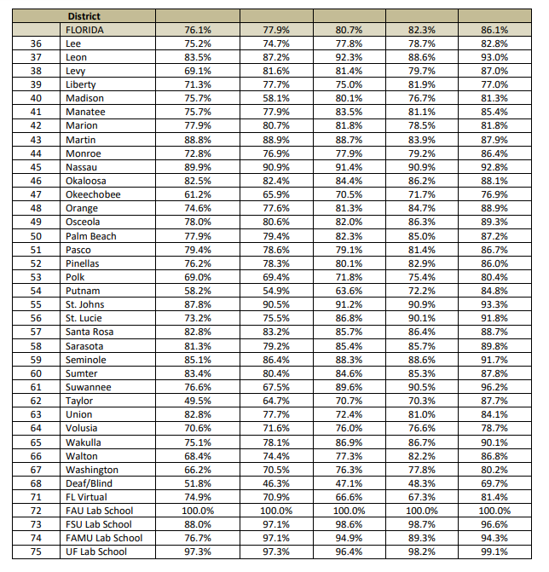

Slide 77
OBJECTIVES:
To provide insights into the Florida Statute 233:061 (1)(g), (1994), as amended by Florida Statute 1003.42(h) 2002 …required instruction in African and African American Studies.
To review the seven (7) elements of the African and African and African American Studies Model.
To provide writers/educators with application techniques that enable the infusion of content across subject areas.
To provide writers/educators with strategies to link African American Studies to the District, State Standards and Benchmarks while integrating relevant content.

Slide 78
AN EFFECTIVE MODEL FOR AFRICAN AND AFRICAN AMERICAN STUDIES CURRICULUM

Slide 79
AN EFFECTIVE MODEL FOR AFRICAN AND AFRICAN AMERICAN STUDIES CURRICULUM
  1. Ancient Africa: Pre-Columbus
  Kingdoms in Africa
  Four Golden Ages of Southern Africa 1) First Pyramid Age 2700BC-2160 BC, 2)Age of Classical Literature2140 BC-1784 BC, 3) Grand Golden Age 1554 BC-1070 BC and 4)500 BC to 1500 AD, Trade, Architecture, Arts, Culture
  Classical Civilizations in Africa
  Diaspora across Africa ,Asia, Pacific Islands and Latin America
  Contributions of Ancient Africa to the World
  MAAT- Reciprocity, Justice, Truth, Balance, Order, Harmony, Propriety
  First Civilization of Europe was established in Crete in 1700 BC
  The ancient Universities that were frequented by Europeans and others
  The role of Arabs in Africa
  Africans in sciences --Imhotep

Slide 80
AN EFFECTIVE MODEL FOR AFRICAN AND AFRICAN AMERICAN STUDIES CURRICULUM
6. The Soul of Africans and African Americans
Myths
Values of the MAAT and the Kwanzaa
The Harlem Renaissance
The inventions of Africans and African American sin the Arts,Sciences,Technology, Engineering, the Ahmed (Rhind) Papyrus and Moscow Papyrus. Problems solved predated the Greek mathematics' by 2000 years
The role of music, jazz, spirituals and classical
The role of Africans like St. Augustine in Catholic Theology and the three African Popes in Rome
African involvement in Islam like Bilal and was second only to Prophet Mohammed.
Imhotep(2800 BC) the father of Medicine and was defied by the Greeks. The Hippocratic oath is dedicated to Aesculapius(Imhotep).
Africans founded the first University called Ipet Isut at Karnak. Moors established over 17 universities.Moors gave Europe first paved and lighted streets and kept science alive while Europe was in its dark ages(Read “From the Browder File” Tony Browder, 1989).

Slide 81
AN EFFECTIVE MODEL FOR AFRICAN AND AFRICAN AMERICAN STUDIES CURRICULUM
7. Contributions of African Americans to the United States of America and to the world
Art-Literature-Music USA, Caribbean and Afro Latino
Politics-Science
Religion- St.Augustine,Bilal
Medicine
Space science …”Hidden Figures Movie”
Development of the Historically Black Colleges and Universities
The Tuskegee Airmen and military contributions
Founding of Hawaii, New Zealand, Australia, Asia, Caribbean, Latin America
African American Inventors/”Hidden Figures”
African American women scientists
The African President’s of the United States and Caribbean, South America
Noble Prize Winners African descent
Contributions in arts, sports, politics, education
And other areas

Slide 82
AN EFFECTIVE MODEL FOR AFRICAN AND AFRICAN AMERICAN STUDIES CURRICULUM
4. Slavery: Post-Columbus in the Americas
Slave Trade in general
Slavery in North America
Slavery in South America
Slavery in Europe
Slavery in Asia
Resistance to enslavement in Guyana, Jamaica, Puerto Rico, Brazil, Pacific Islands, and North America
St. Augustine 1565
Fort Mose
The 1804 Haitian defeat of the Napoleon and the Louisiana Purchase by the USA
Lynchings in Gainesville, Florida and the United States.

Slide 83
AN EFFECTIVE MODEL FOR AFRICAN AND AFRICAN AMERICAN STUDIES CURRICULUM
3. The Invasion and Weakening of Africa
European Colonialism
European Exploitation
Slavery as a long system that began in 1501 until 1808
Tribal/National Conflicts that enabled enslavement
The Expansion Sahara Desert
The resistance to slavery across Africa including Queen Nzinga
The invasion of Africa by the Arabs
Understanding the complicity of Africans

Slide 84
AN EFFECTIVE MODEL FOR AFRICAN AND AFRICAN AMERICAN STUDIES CURRICULUM
5. Neo-Slavery: Abolition, Civil Rights and Constitutional Rights
Abolition /“Uncle Tom Cabin”? Role of Quakers
Bills of Rights
Struggle for Civil Rights
The underground Railroad and the coalition of Blacks and Whites
Slavery in Canada
The Colonization movement back to Africa with Sierra Leonne, Jamaica, Liberia,
The emancipation Proclamation in 1865
The Civil War and its impact on the slavery system
The Trail of Tears and the migration of slaves to Oklahoma
The rescue of slaves by native Indian Nations and tribes in USA and North America

Slide 85
AN EFFECTIVE MODEL FOR AFRICAN AND AFRICAN AMERICAN STUDIES CURRICULUM
2. African Exploration of the World: Pre-Columbus
Trade across world
Moors in Spain
Explorations in Asia,Pacific,Europe and Latin America
African Explorers in the world
African Presence in Europe
African presence in South America, North America and the world
Hannibal defeats Romans and occupy Rome and Italy
African Popes: Victor 186-197 AD, Miltiades 311-314 AD, Gelasius
1492 Africans travelled with Columbus
The Olmecs in the Americas in 1200 AD
1501 First Slaves transported to Hispaniola
1538 Stefanick explorer explored the South West of North America.

